Slide 1
Tropical Layer Robustness Implemented in Convolutional Neural Network
Updated: 4/5/2023

Slide 2
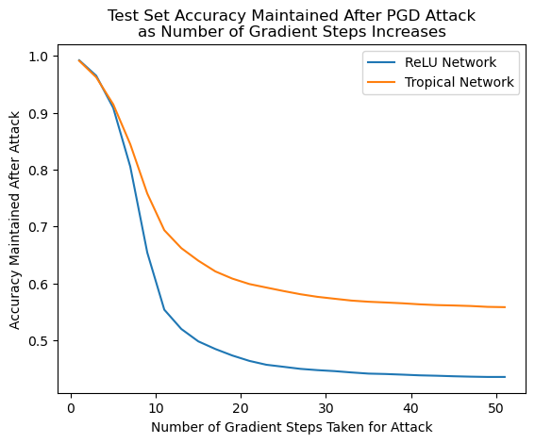
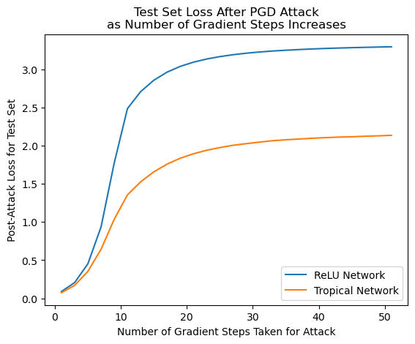
MNIST - Logits

Slide 3
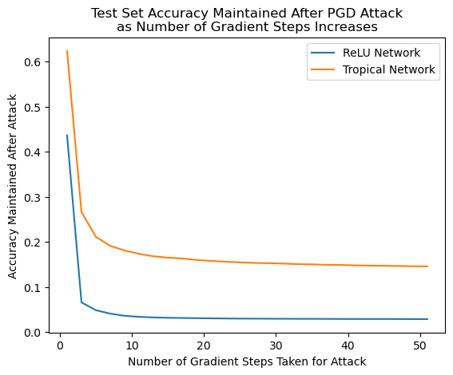
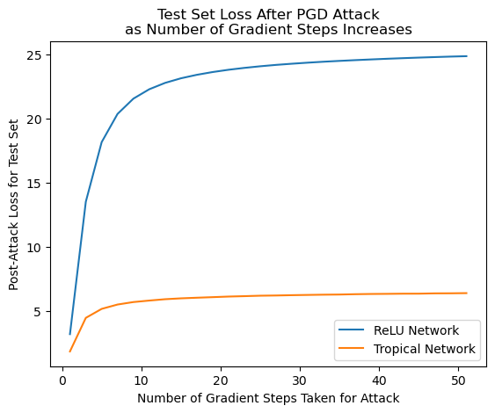
SVHN - Logits

Slide 4
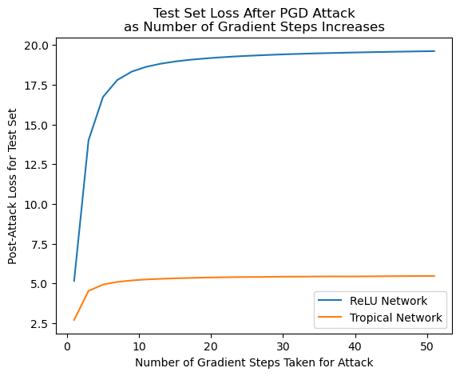
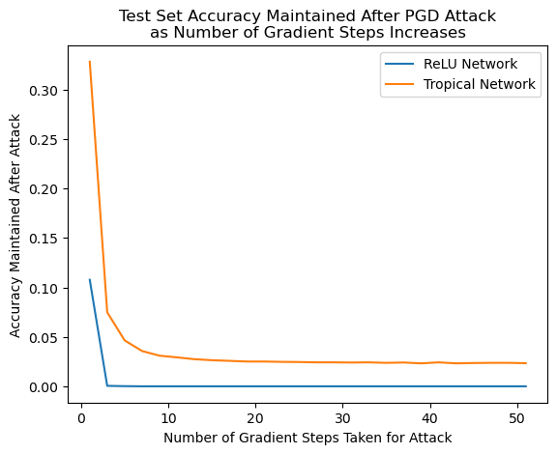
CIFAR - Logits

